Slide 1

Video Streaming with RTSP and RTP
Team ID: TF3

Slide 2


Team TF3
Devansh Patel - 202001262
Dhruv Patel - 202001271
Achyutkumar Shah - 202001449
Jaykumar Navadiya - 202001465
Under the guidance of
IT304 Computer Networks
Video Streaming with
RSTP and RTP Assignment
Prof. Sasidhar
Teaching Assistant Dhara Ma’am

Slide 3
Introduction & Requirement Analysis
01
Function Description
02
TABLE OF CONTENTS
Block Diagram
03
Bonus Exercises
04
Results
05
Understanding RTSP and RTP
Requirements on the client side
Requirements on the server side
Client
ServerWorker
RtpPacket
Block Diagram of the whole system/network
Performance Evaluation: RTP Packet loss and data rate
Three Button Client
The DESCRIBE Request
Testing Environment and Results
Loss rate and Data Rate

Slide 4

Introduction & Requirement Analysis

Slide 5
RTP
(Real Time Transfer Protocol)
RTSP
(Real Time
Streaming Protocol)
UNDERSTANDING RSTP AND RTP
→ Used for delivery of data
→ Uses RTCP as control protocol
→ Uses UDP
→ Port in unprivileged range
→ Control Protocol
→ Directs delivery of stream and does not deliver data
→ Uses RTP for stream and TCP for control
→ Default Port: 554

Slide 6
Requirements on the client side
Requirements on the Server Side
How the client handles the RTSP protocol?
Decide actions when Setup, Play, Pause and Teardown buttons are pressed.
Functions handling these actions are completed (setupMovie, playMovie, pauseMovie, exitClient).
Need to implement sendRtspRequest which is called by each of the functions mentioned above.
Need to implement parseRtspReply
Need to write code for opening a RTP port in openRtpPort function.
Implement Encode Function in RtpPacket.py.
This packetizes all the information of a RTP packet into its header and payload.
Need to put all bits in correct place in the header by manipulating all the bits and bytes.

Slide 7

Function Description

Slide 8
The Constructor __init__
Client.py
Intializes the following properties of the class.
master
serverAddr and serverPort
rtpPort
fileName
rtsqSeq
sessionId
requestSent
teardownAcked
frameNbr

Slide 9
connectToServer
createWidgets
connectToServer
handler
openRtpPort
listenRtp
Client.py
setupMove, playMovie,
pauseMovie and exitClient
opens TCP socket at client and connects to the TCP socket at server
Creates a GUI with 4 buttons and a label.
Updated for user friendly interface
opens TCP socket at client and connects to the TCP socket at server
For preventing unexpected or rather mistaken exits
Opens a UDP port, sets a timeout for it and bind it with RTP port on server
For listening to the incoming RTP packets, decoding them, displaying them as a frame. Handles the sequence of the frames. Also handles PAUSE and TEARDOWN RTSP packets by stop listening and closing the port when TEARDOWN RTSP packets have been received.
These 4 methods corresponds to 4 actions when the user presses the button. playMovie creates a thread for listening to incoming RTP. exitMovie destroys the widgets and cleanup the cache files

Slide 10
updateMovie and writeFrame
sendRtspRequest
parseRtspReply
Client.py
recvRtspReply
2 helper methods to show the payload as a image on the video label in GUI
Checks the state and allows only the request that can be sent according to the state of the client.
Sends Rtsp Request and initializes sequence number as 1 in case of SETUP request and increments it in case of any other requests.
Contents of the packets are identical, except for the request code.
We have to encode the request because strings can not be sent in python3. the data to be sent must be of type bytes. we use encode() for getting this job done.
Parses the RTSP message received from served, perform several checks and update the state of the client based on that.
Uses split() function of python3
Checks: is RTSP Sequence number same? is the Session ID same?
Updating the state of the client:
we use requestSent property for the task.
SETUP: then state will be updated to READY and RTP port will be opened by calling openRtpPort.
PLAY: State will be updated to PLAYING
PAUSE: state will be updated to READY
TEARDOWN: state will be updated to INIT
Runs in another thread, receives Rtsp Replies. Decodes it in utf-8 encoding then passes it to parseRtspReply method.
Closes RTSP socket on client on a TEARDOWN Reply

Slide 11
the constructor __init__
processRtspRequest
recvRtspRequest
ServerWorker.py
sendRtp
recvRtsp
properties are stored in one dictionary named clientInfo.
Parses the RTSP Request by using split() and updates the state and sends a reply.
SETUP: State will be set to READY, a random Sesssion ID will be generated.
PLAY: State will be set to PLAYING, an UDP port will be opened for streaming RTP Packets in a new thread.
PAUSE: State will be updated to READY and the streaming thread will be stopped.
TEARDOWN: The streaming thread will be turned off and RTP socket will be closed.
Runs in another thread,
listens to the incoming RTSP Requests and decode it in utf-8 format. Then passes it to processRtspRequest method.
Runs in another thread,
continuously stream video frame as Rtp packets to client every 50ms.
Gets the next video frame using helper methods in VideoStream.py and then puts it in a valid RTP Packet and sends it.
Makes the reply packet and sends it to the client. 3 RTSP status codes: 200 for OK, 404 for requested file not found and 500 for connection error.

Slide 12
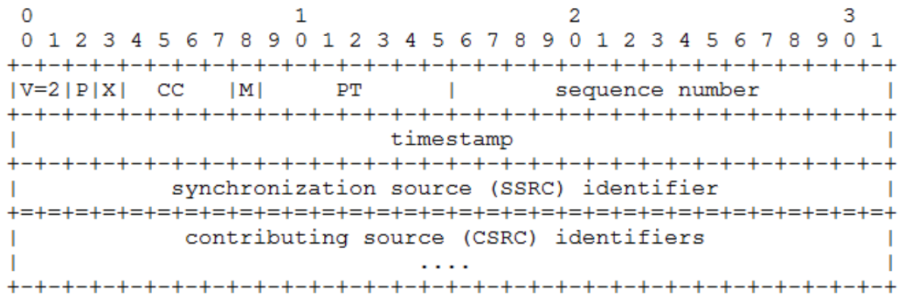
RtpPacket.py
encode
decode
Puts bits and bytes of their values in the header field correctly in their place.
1st byte: 2 bits for version, 1 padding bit, 1 extension bit, 4 bits for contribution source bit.
2nd byte: 1 marker bit, 7 bits for payload type.
Next 2 bytes: sequence number (big-endian).
Next 4 bytes: timestamp (big-endian).
Next 4 bytes: SSRC (big-endian).
Adding the payload to the packet.
Separates header and payload from a whole RTP Packet.

Slide 13

Block Diagram

Slide 14
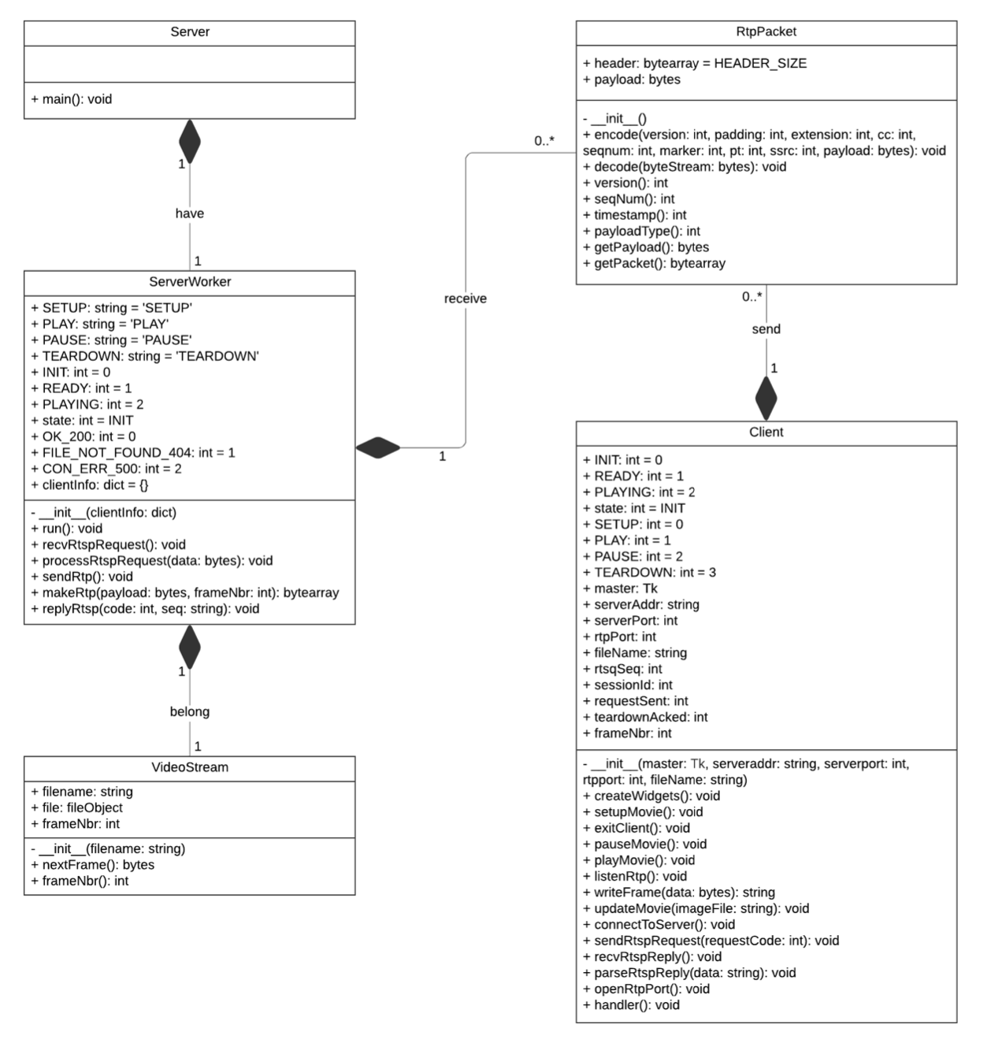
Block/ Class Diagram

Slide 15

Bonus Exercises

Slide 16
RTP Packet loss rate
Implementation
We need to calculate how many packets were lost and how many packets were sent for finding packet loss rate.
For finding packets that were lost, compare the sequence number of the received RTP packet to the frame number that it should be, which is the current frame number plus 1. If it is not equal, we have a packet loss.
For finding total number of packets sent, it is the current frame number at the time the packet loss rate is calculated.
Performance Evaluation

Slide 17
RTP Packet loss rate
Code (listenRtp method) - for detecting packet loss
if self.frameNbr + 1 != rtpPacket.seqNum():
self.lossCounter += (rtpPacket.seqNum() - (self.frameNbr + 1))
print("[*]Packet loss!")
Code (exitClient method) - for printing packet loss at exit time
if self.frameNbr != 0:
lossRate = self.lossCounter / self.frameNbr
print("[*]RTP Packet Loss Rate: " + str(lossRate) +"\n")
Performance Evaluation

Slide 18
RTP Packet data rate
Implementation
Start a timer when the Play button is pressed, and end it when the Pause button is pressed, so that streaming time can be evaluated. The number of video data received is the total length of all the RTP packets’ payloads.
Performance Evaluation

Slide 19
RTP Packet data rate
Code (listenRtp method) - for detecting packet loss
self.bytesReceived += len(rtpPacket.getPayload())
Code (parseRtspReply method, PAUSE Case) - for printing data rate when paused
dataRate = int(self.bytesReceived / (time.time() - self.startTime))
print("[*]Video data rate: " + str(dataRate) + " bytes/sec\n")
Performance Evaluation

Slide 20
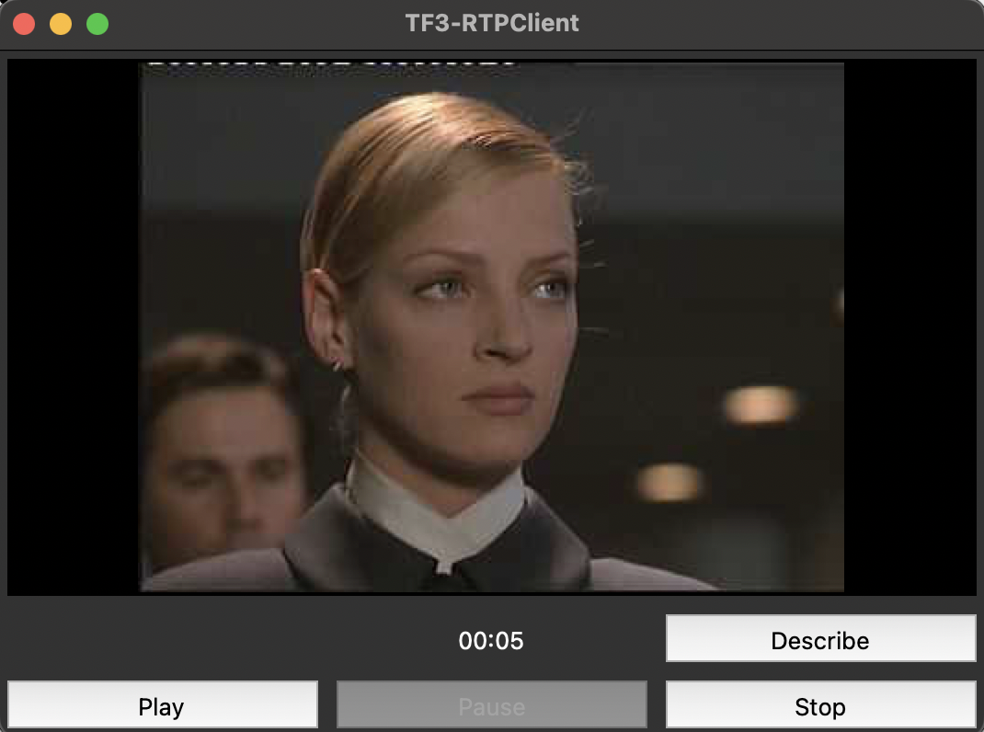
A client with only 3 buttons: Play, Pause and Stop
Implementation
When the Play button is pressed for the first time we send a SETUP RTSP Request to the server and for the Stop button, we just send a TEARDOWN RTSP Request to the Server.
Three Button Client

Slide 21
Code (playMovie method)
def playMovie(self):
"""Play button handler."""
# If it's the first time PLAY is clicked, send SETUP
if self.state == self.INIT and self.firstPlay:
self.sendRtspRequest(self.SETUP)
self.firstPlay = False
# Wait until ready
while self.state != self.READY:
pass
if self.state == self.READY:
# Create a new thread to listen for RTP packets
threading.Thread(target=self.listenRtp).start()
self.playEvent = threading.Event()
self.playEvent.clear()
self.sendRtspRequest(self.PLAY)
Three Button Client

Slide 22
Describe button added to the client.
Client send a RTSP DESCRIBE Request and Server replies with storing a current session information in a file named session.txt.
Implementation
Create one button: DESCRIBE
Create one sendRtspRequest Case
Create ParseRtspRequest Case
Modify the ServerWorker accordingly.
The DESCRIBE Request

Slide 23
GUI updated to show how long the video has been played.
Implementation
Multiply the frame number of the current frame by 0.05 and take the integer part
Code (Appended in listenRtp method)
# Show the current streaming time
currentTime = int(currFrameNbr * 0.05)
self.timeBox.configure(text="%02d:%02d" % (currentTime // 60, currentTime % 60))
Streaming Time

Slide 24
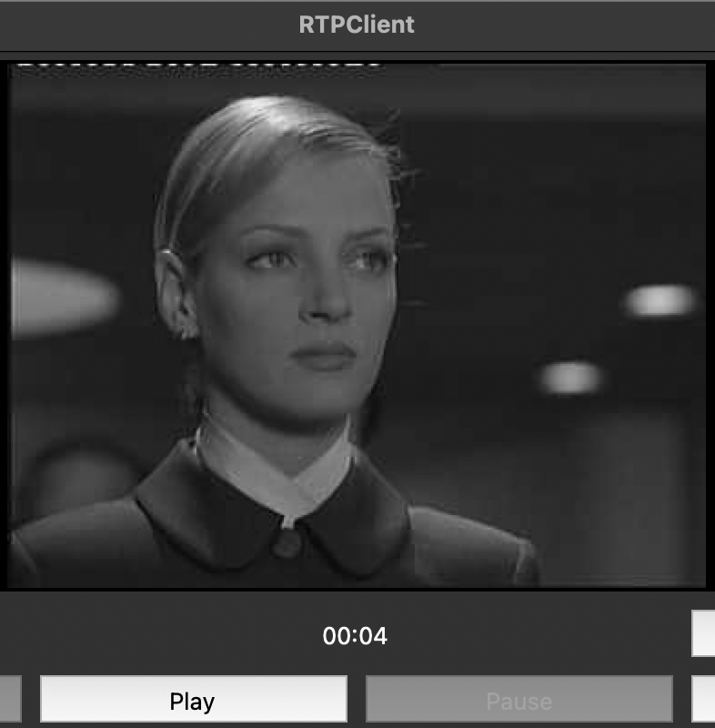
Results & Testing of the Application

Slide 25
✅ Testing locally on 1 Machine
✅ Testing remotely on 2 Machines
Testing Environment & Results
✅ Interaction with the Client
✅ Streaming and Termination
Machine: Macbook Air M2, 8 GB RAM, 8 Processor Cores
Machine 1: Macbook Air M2 (Server), 8 GB RAM, 8 Processor Cores
Machine 2: Macbook Pro 16 (Client), 16 GB RAM, 6 Processor Cores
Interaction with the client was very good. The buttons felt responsive and functional. Disabling the unnecessary buttons feature was also working perfectly.
The video was streamed smoothly without any noticeable lags. Though There was a slight delay in the stream. After 25 seconds the client terminated successfully as the video ended.

Slide 26
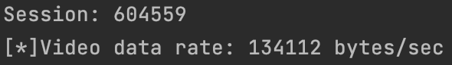
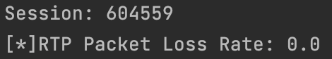
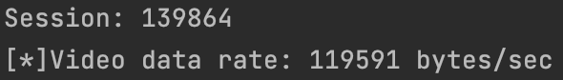
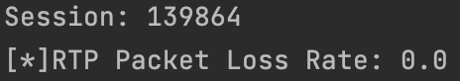
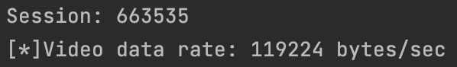
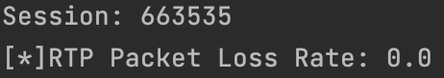
1st Experiment
Loss Rate and Data Rate
2nd Experiment
3rd Experiment
Done locally on one Machine,
Macbook Air M2, 8 GB RAM,
8 Processor Cores
Done locally on one Machine,
Macbook Air M2, 8 GB RAM,
8 Processor Cores
Done remotely on 2 Machines,
Machine 1: Macbook Air M2 (Server), 8 GB RAM, 8 Processor Cores
Machine 2: Macbook Pro 16 (Client), 16 GB RAM, 6 Processor Cores

Slide 27

User Manual

Slide 28
01 Install Python3 from python.org
02 Install PIL by running pip3 install Pillow
03 Go to the Project folder by using cd command
USER MANUAL (for MAC Users)
04 Start the server by running
python3 Server.py <port no.>
05 Start the client by running
python3 ClientWorker.py <server_ip>
<server_port_no.> <RTP_port> movie.Mjpeg
06 For running 3 button client, skip step 5 and run
python3 ClientWorker3Button.py <server_ip>
<server_port_no.> <RTP_port> movie.Mjpeg
Note RTP_Port is between 1025 and 65536
For running remotely, find out the ip of server by running ipconfig getifaddr en0

Slide 29


THANKS!
The Project source code and Presentation file is available at
Reach out to us at
202001262@daiict.ac.in
202001271@daiict.ac.in
202001449@daiict.ac.in
202001465@daiict.ac.in

